Slide 1
PiXYZ Plugin for Unity Samples
Github Samples Specification
Olivier Giniaux – Feb 2019

Slide 2
Current Issues
Packing samples with the plugin delays the shipping of releases as samples requires their own QA
People expect more stability from samples shipped with the product than downloadable open source samples
Impossible to edit or add samples once it’s shipped
People need to buy or get a trial to know about the samples and grasp possibilities

Slide 3

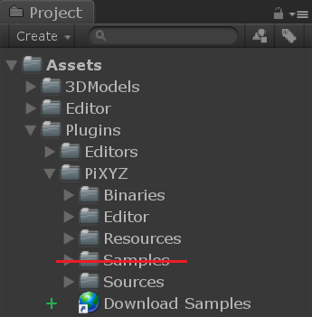


Solution
Create Github Repository
Move samples outside of the unitypackage
Add link in unitypackage to related branch .zip or unitypackage release
Add link in unitypackage to related unitypackage release
Repository: plugin-for-unity-samples
Contributor: ogxd (Olivier Giniaux)
First release expected for 2019.1

Slide 4
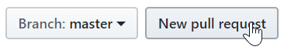
Workflow
Content
Unity project with all samples
No plugin embedded
Branches
One branch per PiXYZ Plugin for Unity major release (2019.1, 2019.2, …)
Branches are made from master
Branches should be working
Internal Devs
Gently ask olivier.giniaux@pi.xyz or fabrice.baeli@pi.xyz for rights
External Devs
Make a new pull request on master branch

Slide 5
SAMPLES
Custom Import Settings
Shows what import settings work

Slide 6
SAMPLES
Using Metadatas
Shows how to use metadatas
Create mouseover metadata display

Slide 7
SAMPLES
Custom Tools Actions
Show how new Toolbox and Rule Engine Actions can be created.

Slide 8
SAMPLES
Rule Engine Samples
A set of rule engine rules to show capabilities and usage of the rule engine

Slide 9
SAMPLES
Runtime License Management
Demonstrates how to use the license management API

Slide 10
SAMPLES
Import on Play
Very basic sample that shows how the API can be used to import a model.

Slide 11
SAMPLES
Simple Viewer
Nice rendering quality
Camera controls
Import Window

Slide 12
SAMPLES
Advanced Viewer
Nice rendering quality
Toggle topology lines
Toggle wireframe
Camera controls
Product hierarchy
Selection system
Display metadata
Licensing Window
Import Window
Create nice UI
Cutting plane
Easy & simple VR setup

